Slide 1
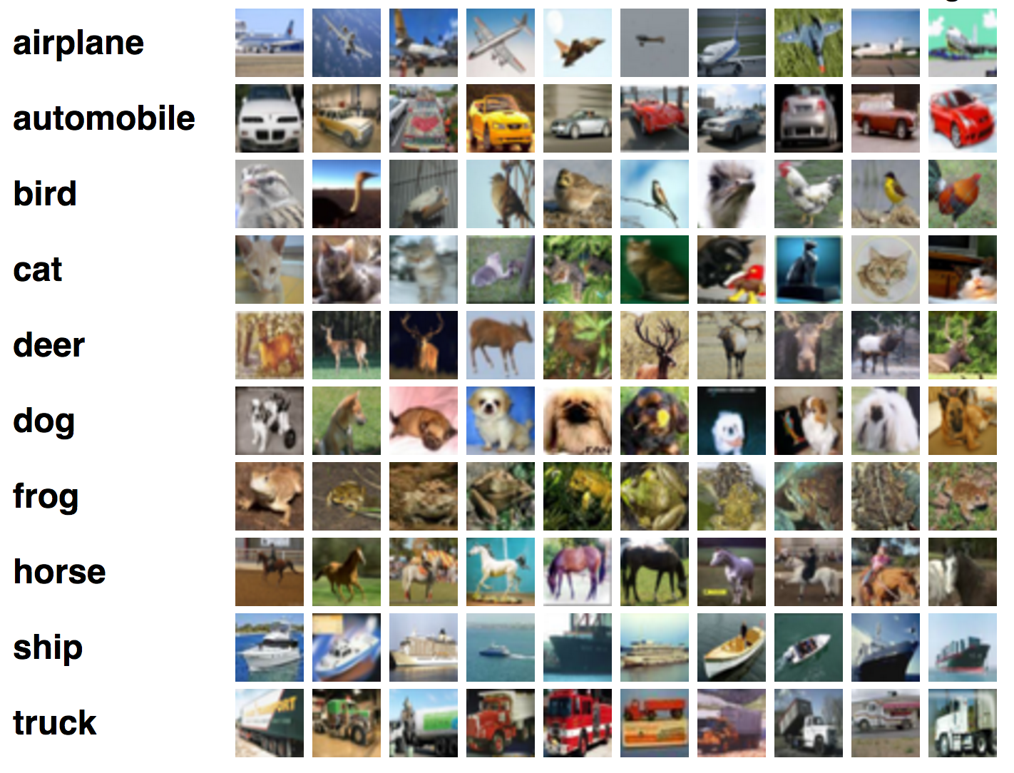
Image classification
Image Processing in cis section 694
(GROUP-6)
Submitted to : Dr.Hongkai Yu
Submitted BY:
Anil Pavuluru
Prudhvi Tej Avula
Yashaswi Dasari

Slide 2
Objectives
Introduction
Objective of the project
Algorithm explanation
Data set
Code, output
Future work
Reference
Conclusion

Slide 3
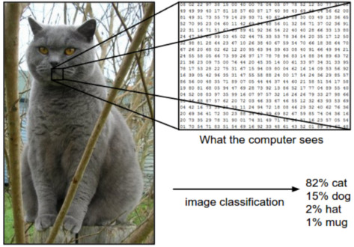
INTRODUCTION
Computer vision is an interdisciplinary and subfield of artificial intelligence that aims to give similar capability of human to computer for understanding information from the images
segmenting images into different
Categories by their features

Slide 4
By labelling the pixels image classification can be done in two ways
Supervised classification
Unsupervised classification

Slide 5
SUPERVISED CLASSIFICATION
is a procedure for identifying
spectrally similar areas on an image.
It requires training data

Slide 6
UNSUPERVISED CLASSIFICATION
It does not compare pixels to be classified.
It is based entirely on the automatic identification.
It requires some parameters from the user.

Slide 7
Objective of the Project
In this paper, our system uses machine learning algorithm to achieve the expected results in the area like computer visions. Our system present SVM and Random Forest, a machine learning algorithm being used for automatic classification the images.
Our system uses the Digit of MNIST data set as a benchmark for classification of grayscale images
By training the images using SVM network we obtain the result in the experimental part it shows that our model achieves the high accuracy in classification of images

Slide 8
Support vector machine
What is SVM?
A support vector machine is a supervised learning algorithm that sorts data into two, building the model as it is initially trained. The task of an SVM algorithm is to determine which category a new data point belongs in.

Slide 9
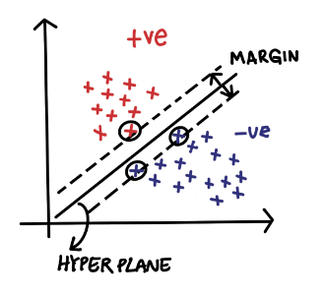
How SVM approach classification problems?
The main objective in SVM is to find the optimal hyperplane to correctly classify between data points of different classes
Where a hyperplane is a boundary that divides the plane. It is a decision boundary that classifies the data points into 2 distinct classes
The data points that are passed through by marginal planes is called Support vectors

Slide 10
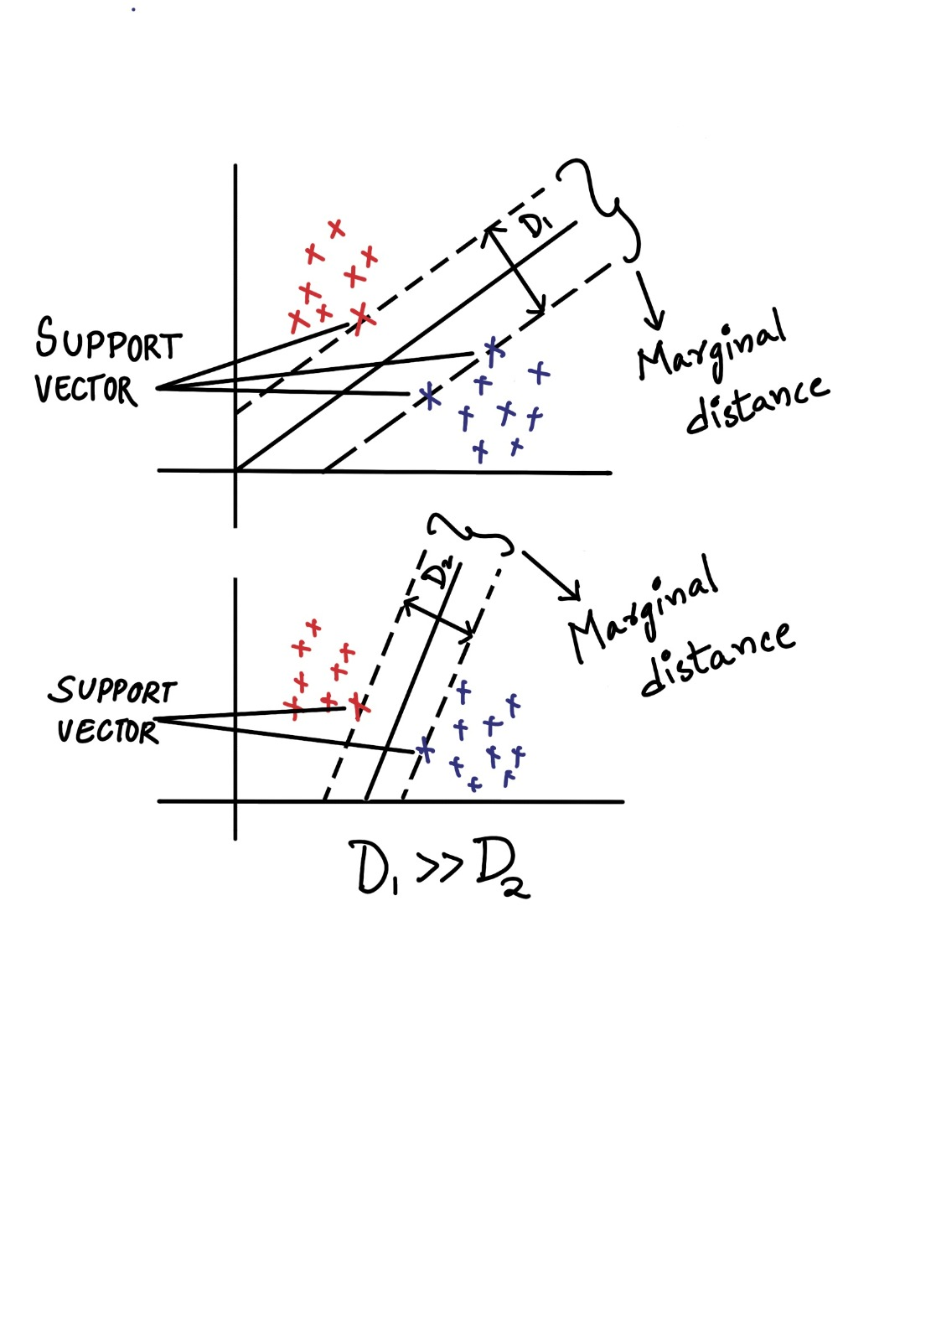
How to choose best hyper plane?
The distance between this two margin planes as marginal distance
The hyper plane with maximum marginal distance is the most efficient hyper plane

Slide 11
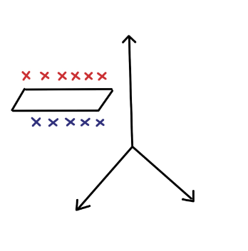
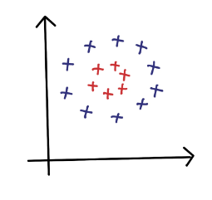
How to solve nonlinear svm’s
By using concept SVM Kernels we can solve the non linear SVMS’s
SVM kernels is used to convert low dimension into high dimension

Slide 12
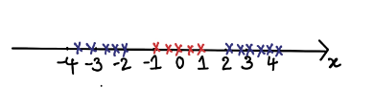
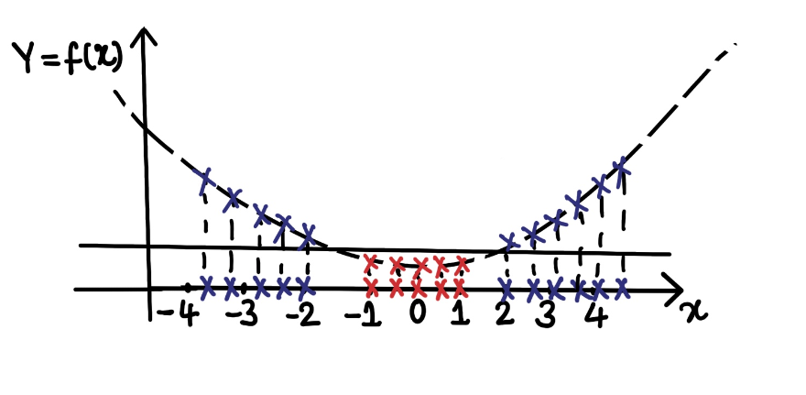
Example using polynomial Kernel

Slide 13

Random Forest
Random Forest is an algorithm that operates by constructing multiple decision trees. The final decision is made based on the majority of the trees and is chosen by the random forest

Slide 14

Decision Tree
Decision tree is a tree shaped diagram used to determine a course of action. Each branch of the tree represents a possible decision, occurrence (or) reaction.
Entropy : It is a measure of randomness or unpredictability in the data set.
Information Gain : A measure of the decrease in the entropy after the data set is split is the information gain.
Leaf Node : A leaf node is a node that carries the classification or the decision.
Root Node: The root node is the topmost decision node, which is where you have all of your data

Slide 15
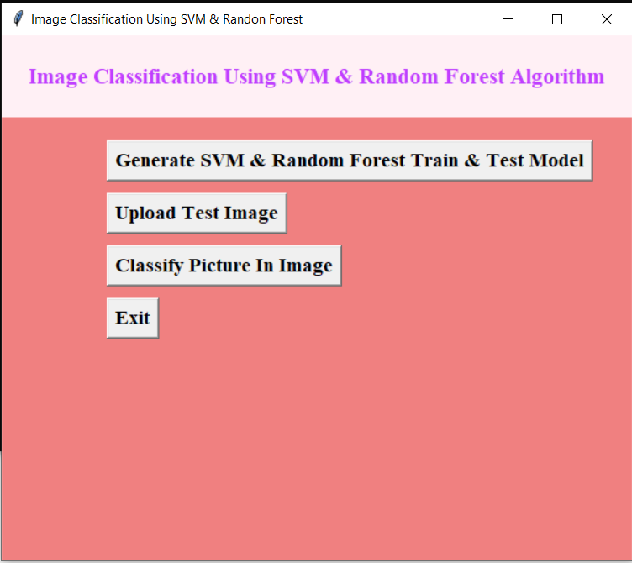
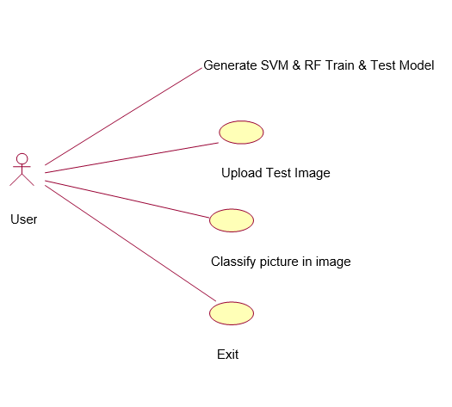
GUI WINDOW

Slide 16
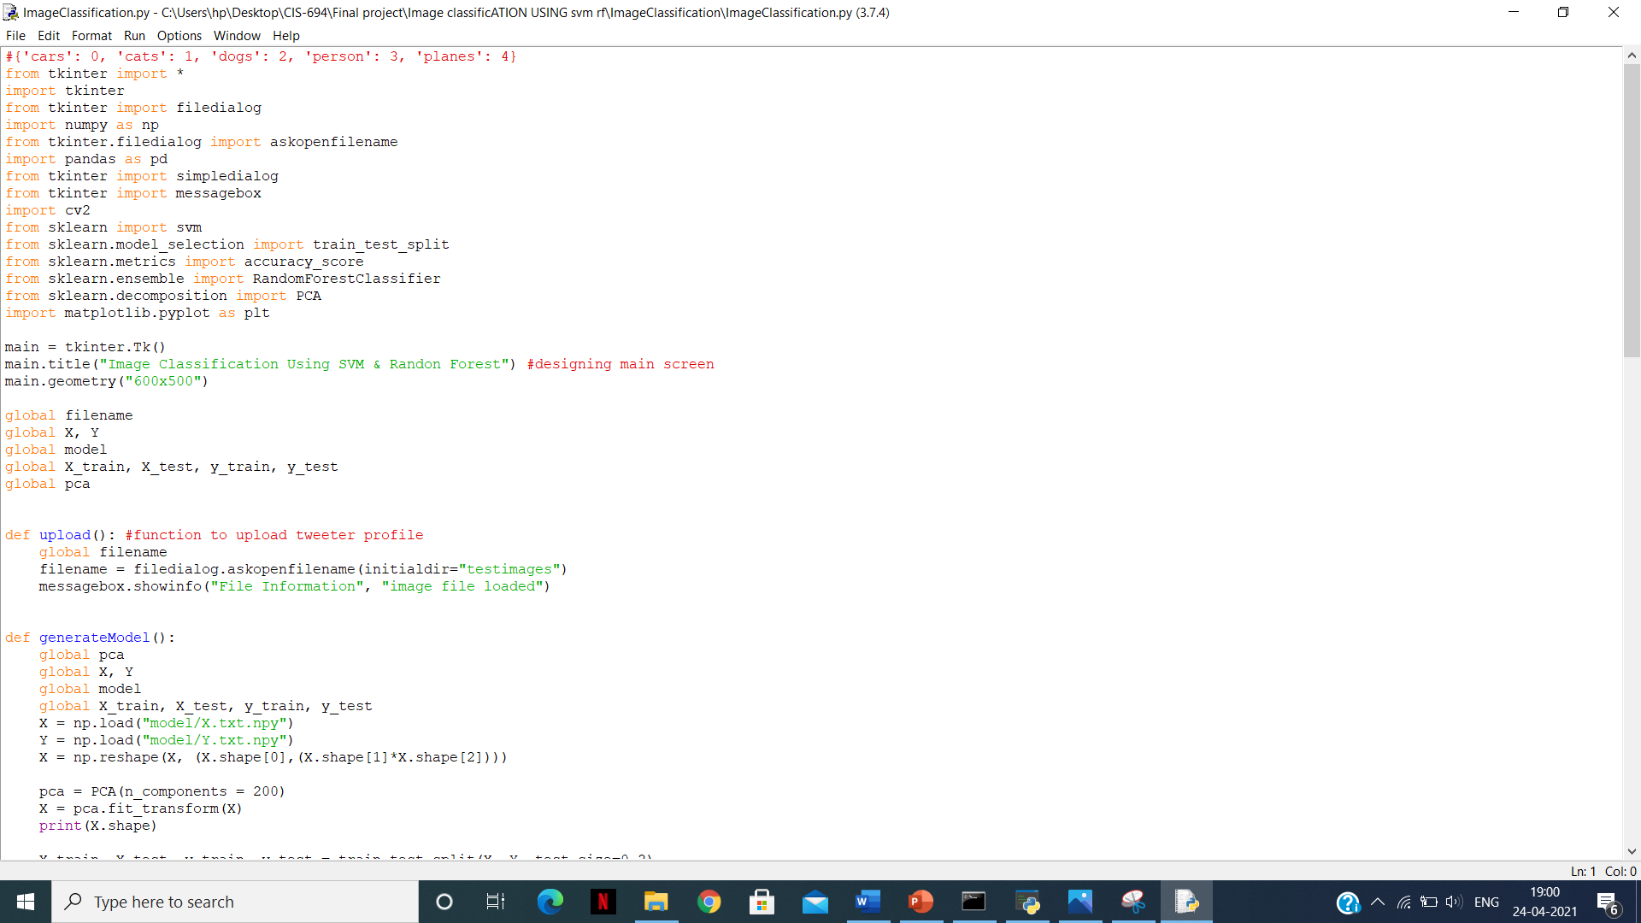
Code image classification:

Slide 17
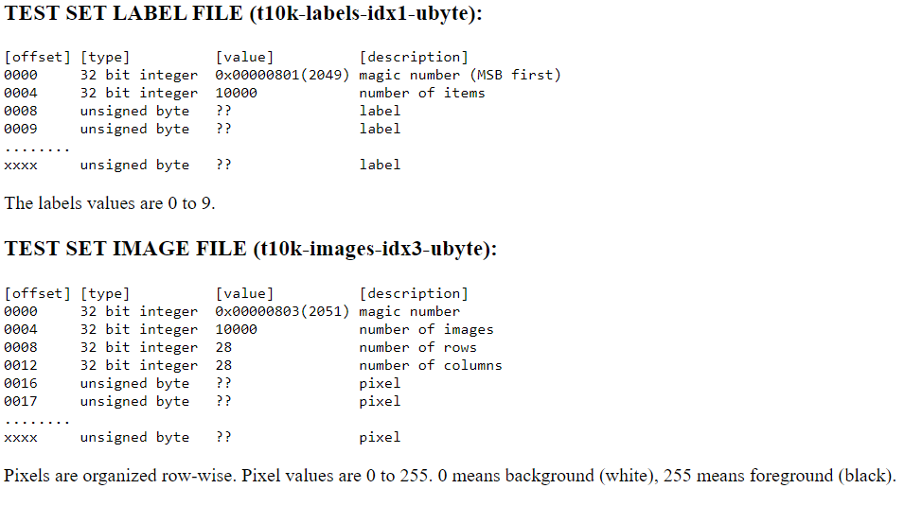
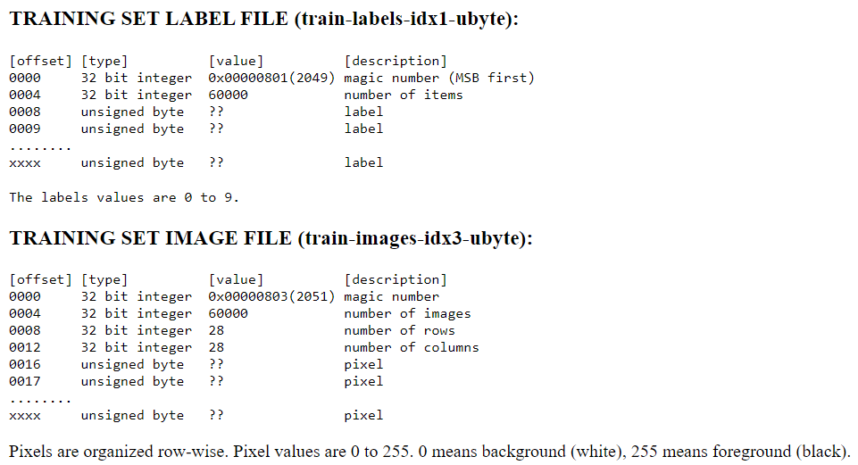
MNIST database

Slide 18
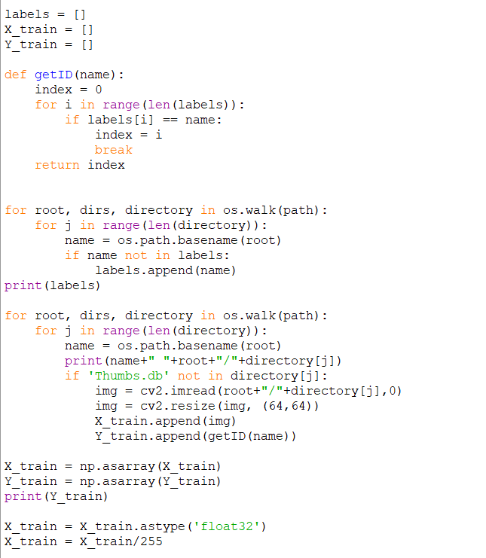
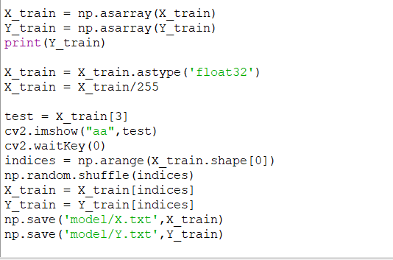
Train and Test

Slide 19
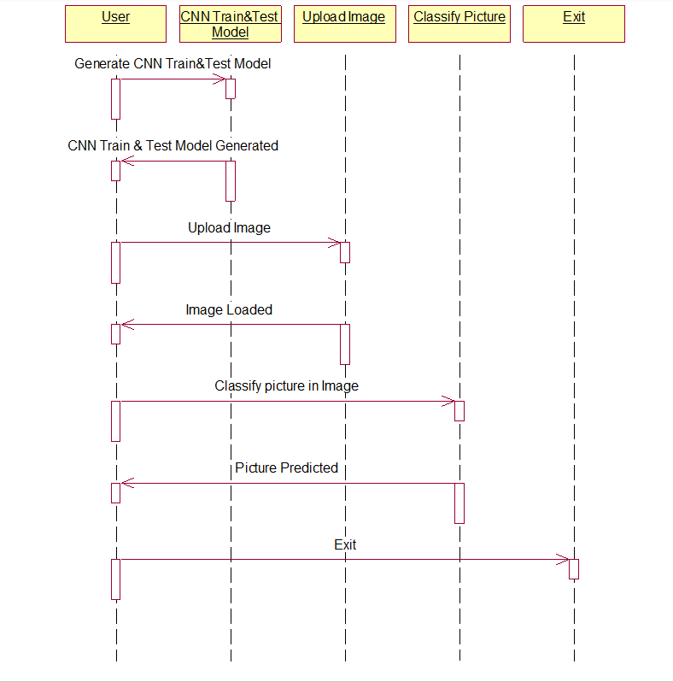
Diagram

Slide 20
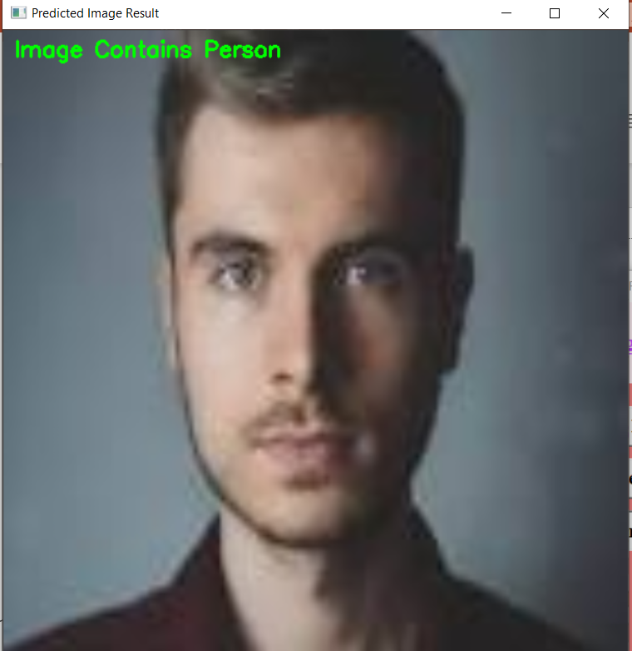
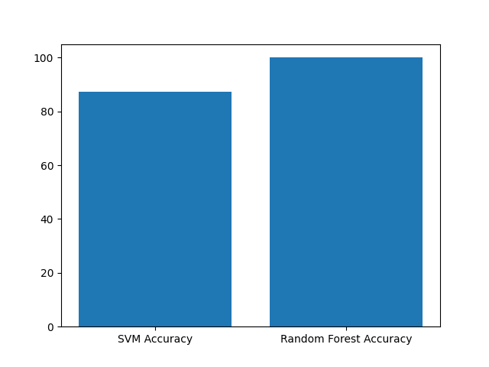
Output

Slide 21
Future work and Conclusion
Images used in the training purpose are small and Grayscale images. The computational time for processing these images is very high as compare to other normal JPEG images. Stacking the model with more layers and training the network with more image data using clusters of GPUs will provide more accurate results of classification of images. The future enhancement will focus on classifying the colored images of large size and its very useful for image segmentation process

Slide 22
References
Zagoruyko, S. and Komodakis, N., 2016. Paying more attention to attention: Improving the performance of convolutional neural networks via attention transfer. arXiv preprint arXiv:1612.03928.
Inception-v4,Inception-ResNetand the Impact of Residual Connectionson Learning Christian Szegedy, Sergey Ioffe,Vincent Vanhoucke ,Alexandrr A.Alemi
Stefan Kahl, Thomas Wilhelm-Stein, Hussein Hussein, Holger Klinck, Danny Kowerko, Marc Ritter, and Maximilian Eibl Large-Scale Bird Sound Classification using Convolutional Neural Networks
Thomas Berg, Jiongxin Liu, Seung Woo Lee, Michelle L. Alexander, David W. Jacobs, and Peter N. Belhumeur Birdsnap: Large-scaleFine-grainedVisualCategorizationofBirds
Bo Zhao, Jiashi Feng Xiao Wu Shuicheng Yan A Survey on Deep Learning-based Fine-grained Object Classication and Semantic Segmentation
Yuning Chai Electrical Engineering Dept. ETH Zurich,Victor Lempitsky Dept. of Engineering Science University of Oxford, Andrew Zisserman Dept. of Engineering Science University of Oxford BiCoS:A BiSegmentation Method for Image Classication

Slide 23
THANK YOU
FOR YOUR ATTENTION

